Slide 1
Introduction to Software Engineering

Slide 2
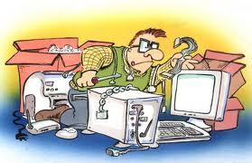
Agile Philosophy

Slide 3
Limitations of most legacy Lifecycles
Traditional models are based on predictive software development methods
Upfront planning
More suitable where there is a clear definition of what needs to be achieved and things are not changing fast
Models do not facilitate periodic customer interactions
Suited for very large projects with complex dependencies
Suitable for some kinds of organizational environments like global, distributed, to some organizational structures etc.
Product lifecycle and its eco-system
People and Skill perspectives
Regulatory perspectives

Slide 4
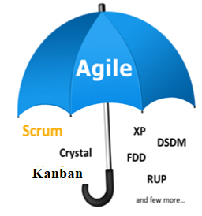


Agile
“Agile" is an umbrella term used to describe a variety of methods that encourage
Continual realignment of development goals with the needs and expectations of the customer.
Its also aimed at reducing massive planning overhead to allow fast reactions to change.
CONTEXT
World is chaotic
Change is inevitable and is the constant
Deliver value to customer as quickly as possible

Slide 5





read - Is valued more than
Agile Manifesto
Individuals and interactions over Processes and tools
Working software over Comprehensive documentation
Customer collaboration over Contract negotiation
Responding to change over Following a plan
Focus on Simplicity in Both the product and the process
Notes:
verbal declaration of the intentions, motives, or views of the issuer

Slide 6
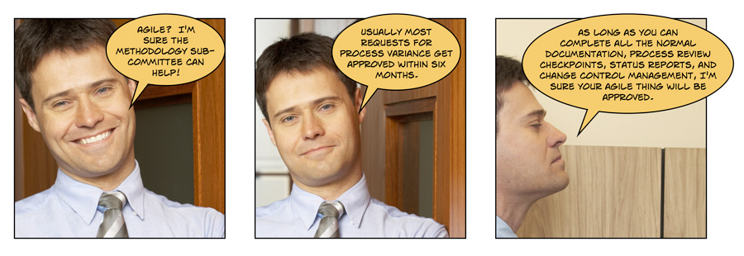
Pun on Agile

Slide 7
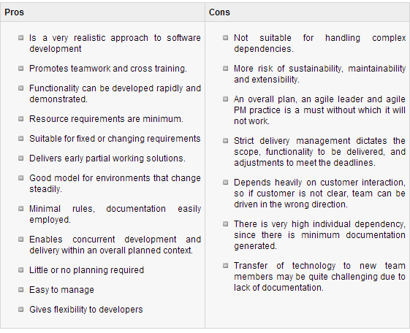
Agile Methodologies

Slide 8
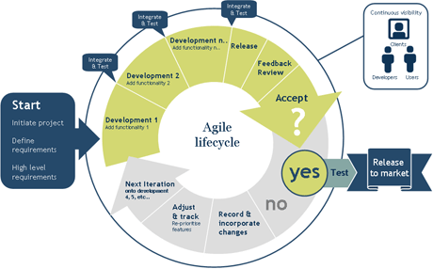
Agile based Lifecycles

Slide 9
SCRUM
Scrum is an agile methodology or framework for developing, delivering and sustaining software components and products
Scrum is an iterative approach towards software development
Scrum words comes from rugby where it’s a formulation of play where everyone has a part and you huddle periodically to take stock
Scrum provides mechanisms to apply agile practices
Scrum is defined by
Roles
Events (ceremonies)
Artifacts
Rules

Slide 10



SCRUM : Roles
Organization is split into small, cross-functional, self-organizing teams.
Product/ Project Owner
Scrum Master
Scrum Team
Scrum Team
Scrum Team
Scrum Team
- made up of contributors to the deliverable
- responsible for delivering shippable increments
- Self organized
- Cross Functional
Scrum Master
- not a manager
- facilitator
- removes impediments
- facilitates meetings
- ensures team adheres to scrum theory and practices
Product Owner - is the voice or rep of the stakeholder/team
Create/manages Product Backlog

Slide 11
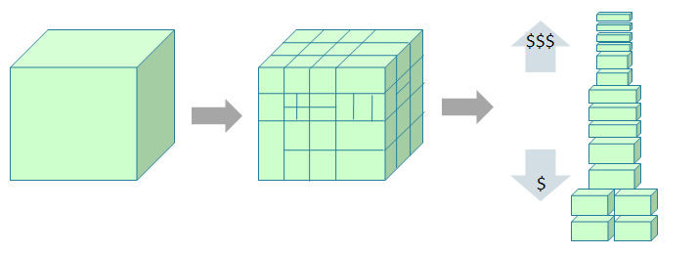


SCRUM : Artifacts
Split your work into a list of small, concrete deliverables. Sort the list by priority and estimate the relative effort of each item.
R
o
a
d
m
a
p
Product backlog
backlog as user stories
Weighted and ranked stories
The project/product is described as a list of features also called Product backlog
The features are described in terms of user stories
The scrum team estimates the work associated with each story and ranks them in the order of importance.
The weighted-ranked features/stories in the backlog results in roadmap
The features/stories in the backlog planned for a sprint is the sprint backlog

Slide 12
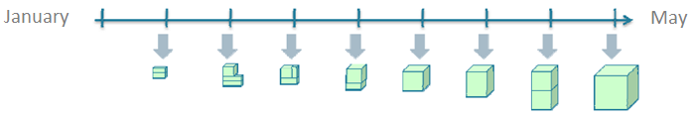
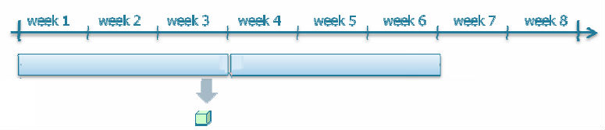
SCRUM : Events
Split time into short fixed-length iterations (called Sprints) usually 2 – 4 weeks, with potentially shippable code demonstrated after each iteration. (its also called time-boxing)
Iteration/ Sprint 1
Iteration/ Sprint 2
The total effort each iteration can accommodate leads to number of user story per iteration
Release
One release may contains number of iterations
Sprint planning meeting is the planning meeting to determine which of the product backlog items will be worked on and delivered in the sprint iteration

Slide 13
SCRUM : Events
Daily scrum meeting or Standup meeting to discuss
What did you do yesterday?
What will you do today?
Any obstacles?
End of the sprint has a finished “shippable product”
Sprint review meeting demonstrates story features. Product owner evaluates against preset criteria's. Gets feedback from clients and stakeholders and ensures the delivered increment meets the business need and helps support reprioritizing of the product backlog and optimize the release plan if needed.
Optimize the process by having a Sprint retrospective after each iteration. It is the final team meeting in the Sprint to determine what went well, what didn't go well, and how the team can improve in the next Sprint. Attended by the team and the ScrumMaster, the Retrospective is an important opportunity for the team to focus on its overall performance and identify strategies for continuous improvement on its processes.

Slide 14
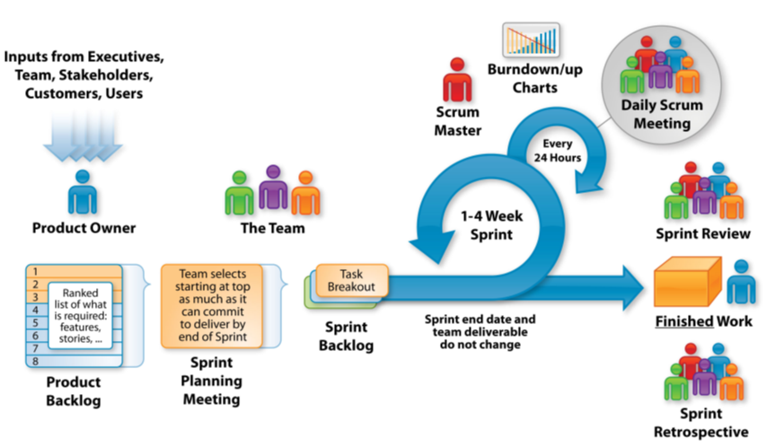
SCRUM : In a nutshell
So instead of a large group spending a long time building a big thing, we have a small team spending a short time building a small thing but integrating regularly to see the whole

Slide 15
SCRUM : Summarizing the framework
Scrum is a lightweight agile framework with broad applicability for managing and controlling iterative and incremental projects of all types.
Demos can be provided after every Sprint
Small working teams to maximize communication, minimize overheads, sharing of tacit and informal knowledge
Adaptable to technical and business changes
Yields frequent software increments that can be inspected, adjusted, tested, documented and built on.
Development work and people who perform it are partitioned into clean low coupling partitions/packets
Constant testing and documentation is performed as the product is built.
Ability to declare a product done whenever done
Teams start with simple Scrum tools like a whiteboard or a spreadsheet to manage the product backlog and the progress of the sprint backlog items.

